Slide 1

Employee Data Analysis using Excel
STUDENT NAME: M. Vinitha
REGISTER NO:312216042
DEPARTMENT:B.Com GENERAL
COLLEGE: Shri Shankarlal Sundarbai Shasun Jain College for Women
1
Notes:
1

Slide 2

PROJECT TITLE
Employee Performance Analysis using Excel
2

Slide 3



AGENDA
Problem Statement
Project Overview
End Users
Our Solution and Proposition
Dataset Description
Modelling Approach
Results and Discussion
Conclusion
3/21/2024 Annual Review
3

Slide 4

PROBLEM STATEMENT
Measurement Difficulties: Many organizations face challenges in establishing reliable metrics to quantify employee performance accurately. Traditional performance evaluation methods often fail to capture the full scope of an employee's contributions, leading to incomplete or biased assessments.
Impact of Performance Factors: There is a need to understand how various factors—such as motivation, job satisfaction, work environment, and leadership—impact employee performance. This understanding is crucial for developing strategies that enhance performance.
Alignment with Organizational Goals: Ensuring that employee performance metrics align with organizational goals and objectives is a significant challenge. Misalignment can lead to inefficiencies and reduced effectiveness in achieving strategic targets.
4

Slide 5

PROJECT OVERVIEW
The system's streamlined methods of data collection, analysis, and visualization are intended to improve performance data management's effectiveness.
It includes the subsequent elements:
Gathering Data:
Gather information on key performance indicators (KPIs) like tasks finished, attendance records, sales income, operational effectiveness, and manager assessments.
Formulas and Data Entry:
Arrange the information in Excel tables to guarantee well-organized storage.
Apply the proper formulas to calculate efficiency metrics, performance scores, and other pertinent indicators.
Formatting on Condition:
To find and draw attention to performance anomalies, such as underperformers and top performers, use conditional formatting techniques.
Tools for Data Analysis:
Utilize Excel's analytical tools, such as PivotTables, charts, and trend lines, to compile and display performance information for a range of categories, such as teams, departments, and time periods.
5

Slide 6




WHO ARE THE END USERS?
Managers
Employees
Stakeholder
Executives
6

Slide 7

OUR SOLUTION AND ITS VALUE PROPOSITION
It allows the company to methodically monitor, evaluate, and display worker performance according to important factors:
Automated data collection and calculation:
Using automated data collection and calculation helps the organization avoid issues.
Alerts:
By employing conditional formatting, it is possible to recognize top performers and pinpoint areas of underperformance.
Detailed reporting:
It assists management and HR in making wise decisions and preventing misunderstandings.
Customizable dashboards:
These aid in comparison-making and performance trend visualization for HR and management.
7

Slide 8
Dataset Description
The dataset used in this employee performance analysis contains various performance related attributes, which includes,
Employee ID
First name
Last name
Business unit
Employee status
Employee type
Employee classification type
Performance score
Current employee rating

Slide 9

THE "WOW" IN OUR SOLUTION
Performance level=IF(AND(Z8>=5),"VERY HIGH",IF(AND(Z8>=4),"HIGH",IF(AND(Z8>=3),"MED","LOW")))
3/21/2024 Annual Review
9

Slide 10
MODELLING
1)DATA COLLECTION:
THE DATA HS BEEN COLLECTED THROUGH EDNUT DASH BOARD.
2)FEATURE COLLECTION:
THE LISTED 10 FEATURES WERE TAKEN FOR THE ANALYSES OF DATA.
3)DATA CLEANING:
IDENTIFYING THE MISSING VALUES.
FILTERING OF THOSE MISSING VALUES
4)CALCULATION OF PERFORMANCE LEVEL:
BY CONSIDERING THE CURRENT EMPLOYEE RATING, I FOUND THE PERFORMANCE LEVEL USING THE FORMULA.
5)SUMMARY OF PIVOT LEVEL:
SEGREGATING OF CERTAIN FEARURES TO ROWS, COLUMNS ,HEADING AND SO ON.
6)VISUALIZTION:
ONCE COMPLETED WITH PIVOTTABLEE, CREATED THE GRAPH FOR PREISE VISUALIZATION.
10

Slide 11
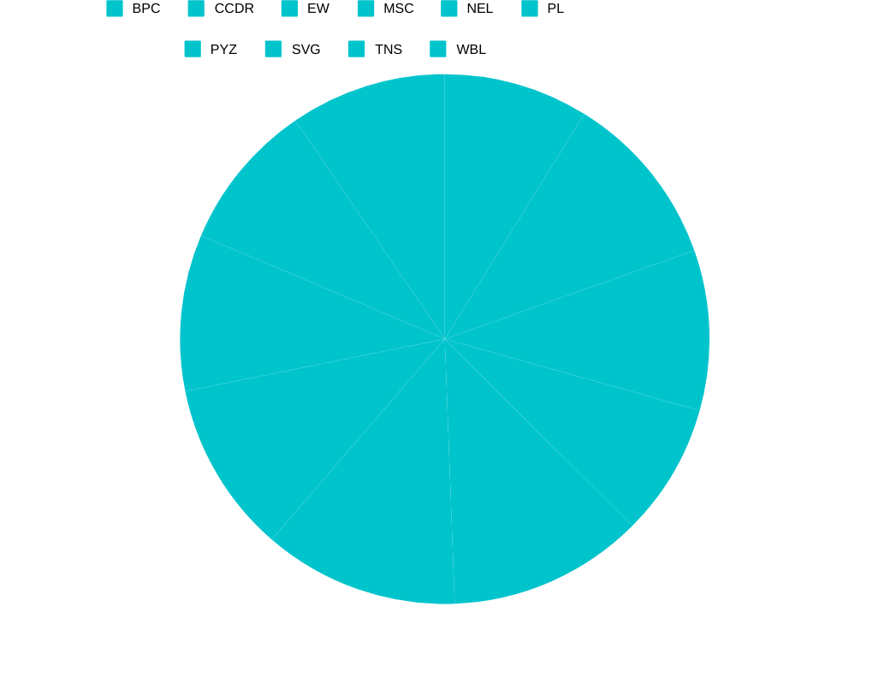
RESULTS
11

Slide 12
conclusion
This system provides organizations with an effective, efficient, and adaptable way to maximize employee performance management. Enhancing the accessibility and actionability of performance data fosters ongoing workforce productivity improvements and the development of a goal-oriented, driven team.
For companies seeking to enhance workforce management, putting in place an Excel-based employee performance analysis system is a wise and doable strategy. It makes it easier to monitor important performance indicators and offers instantaneous insights, assisting managers in making decisions based on facts. Due to its adaptability, affordability, and scalability, the system is available to companies of all sizes.

